Slide 1

李恩心 | 1820232039 | 阮思捷老师 | 2026年5月16日
RELIABLE FILE TRANSFER SYSTEM
GO-BACK-N PROTOCOL
COMPUTER NETWORKS COURSE PROJECT

Slide 2

Project Overview
Project Objectives
Implement reliable bidirectional file transfer over UDP based on the Go-Back-N protocol, ensuring reliability in the presence of packet loss and data corruption.
Sliding Window Mechanism
Go-Back-N uses a sliding window approach, allowing the sender to continuously transmit multiple data packets, ensuring transmission reliability through cumulative acknowledgments and timeout retransmission.

Slide 3
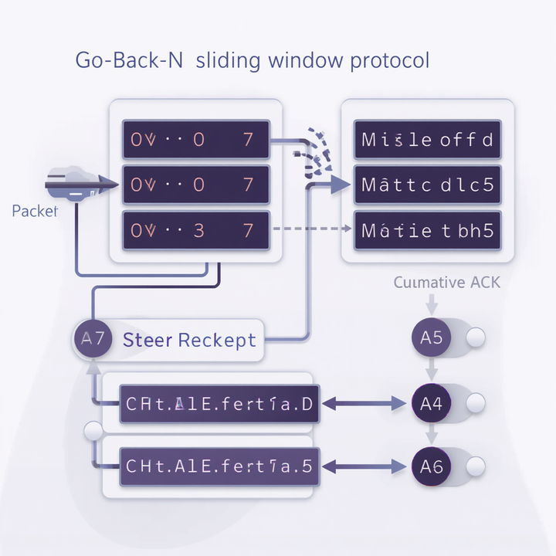
Go-Back-N Protocol
Fundamentals
Sliding Window Mechanism
Window size (SWSize) controls how many unacknowledged packets can be in flight simultaneously.
Cumulative Acknowledgments
Sender transmits multiple packets without waiting for individual ACKs; receiver sends cumulative ACKs.
Timeout & Retransmission
When timeout expires, sender retransmits all unacknowledged packets from the window starting point.
3/20

Slide 4
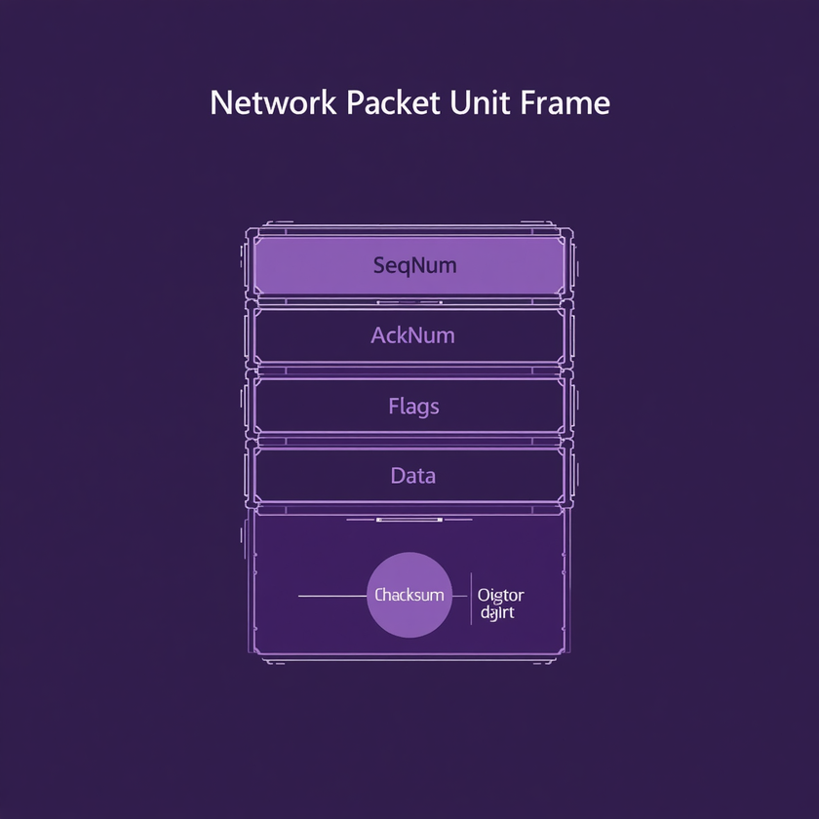
PDU Frame
Structure
Header Fields
SeqNum (4 bytes): sequence number
AckNum (4 bytes): cumulative ACK number
Flags (1 byte): 0 = DATA, 1 = FIN (finish)
Payload & Checksum
Data payload: ≤4KB (file chunk)
Checksum (2 bytes): CRC-CCITT for error detection
李恩心 | 1820232039

Slide 5
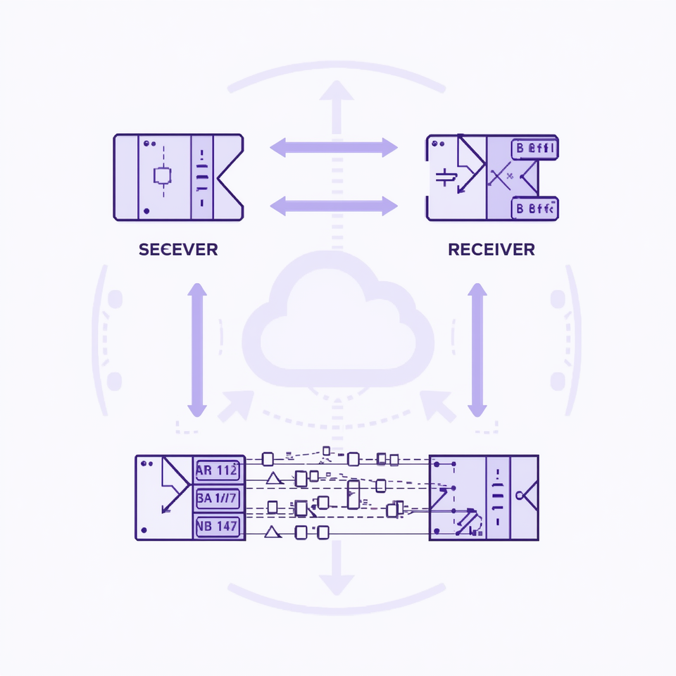
System
Architecture
Sender Workflow
Reads file and splits into chunks, sends packets within sliding window, handles timeout-triggered retransmission of unACKed packets.
Receiver Workflow
Receives packets, validates sequence number and CRC checksum, accepts in-order packets only, sends cumulative ACKs, writes to output file.

Slide 6

Configuration
Parameters
Network & Data Settings
UDPPort: 42039, DataSize: 1024 bytes per packet, SWSize (sliding window): 8 packets.
Timing & Simulation
Timeout: 1000ms, ErrorRate and LostRate parameters for packet corruption and loss simulation.
Sequence Configuration
InitSeqNo: 0 (initial sequence number for packet ordering and tracking).

Slide 7

Error Simulation
Approach
Packet Loss Simulation
Randomly drops 1 in N packets based on LostRate parameter, causing sender timeout and triggering Go-Back-N retransmission.
Packet Corruption Simulation
Randomly flips bits in 1 in N packets based on ErrorRate parameter, detected by CRC-CCITT checksum validation at receiver.

Slide 8
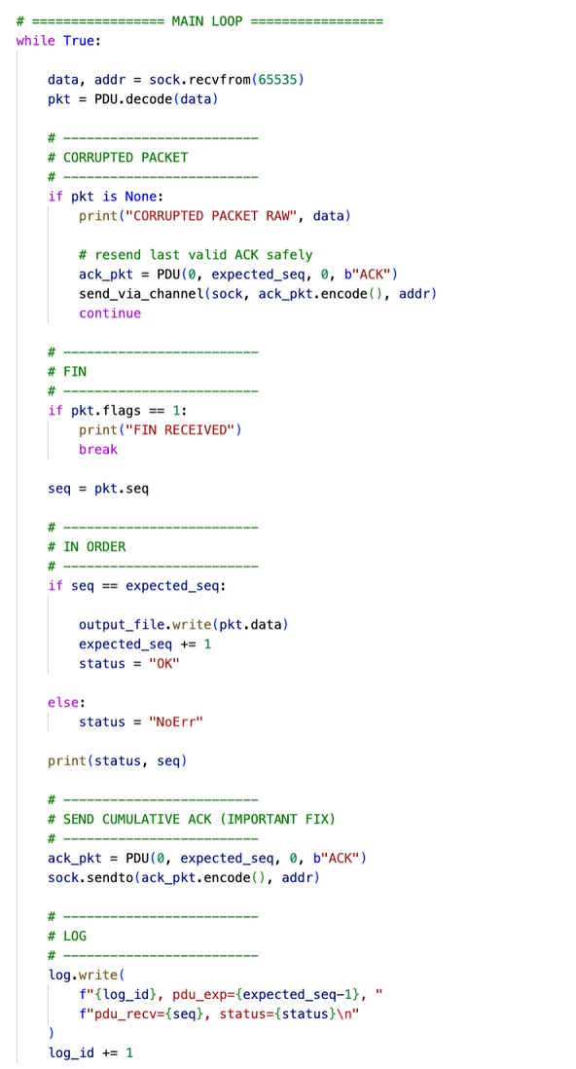
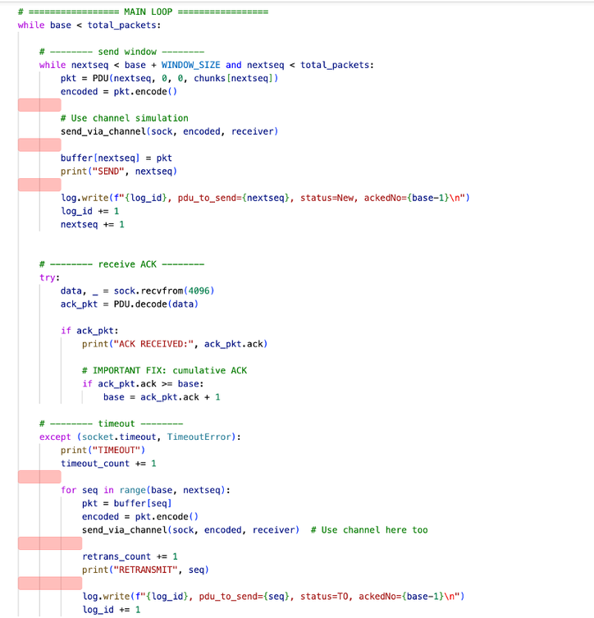
Code

Slide 9

Performance Setup
and Metrics
Test File Configuration
File size: 3 MB (3,145,728 bytes), Packet size: 1,024 bytes → Total 3,072 packets transmitted.
Network Environment
Localhost simulation for controlled testing conditions with configurable error and loss rates.
Key Performance Metrics
Throughput (KB/s), retransmission count, transfer efficiency (%), and total transfer time (seconds).

Slide 10
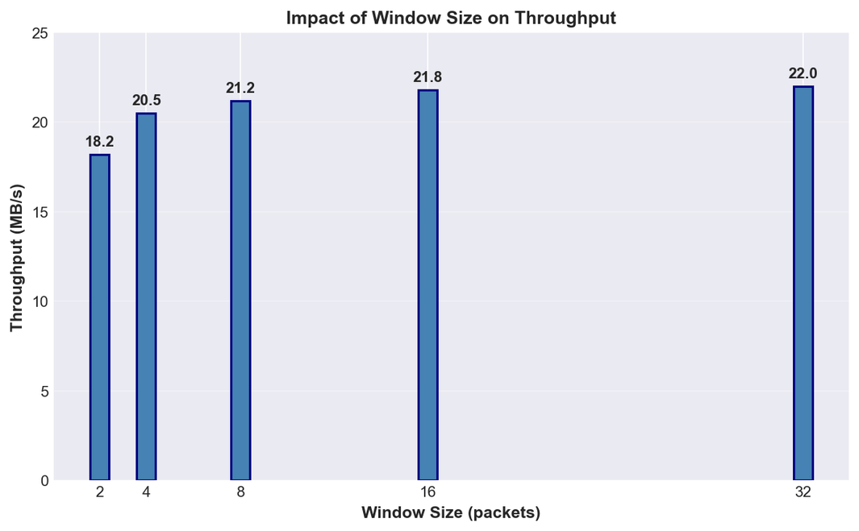
Impact of Window Size
on Throughput
Throughput improves significantly as sliding window size increases from 2 to 32 packets.
Diminishing returns observed beyond window size 16, indicating optimal configuration range.
9/20

Slide 11
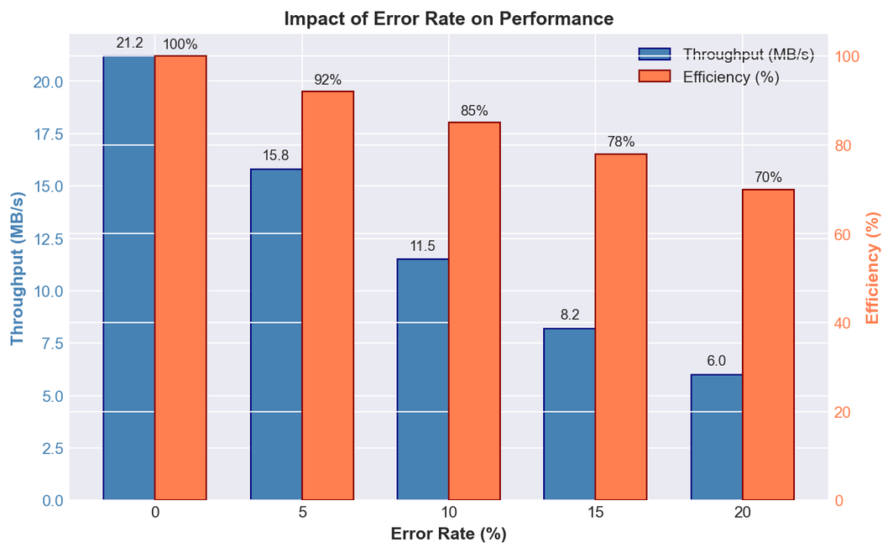
Impact of Error Rate
on Performance
As packet error rates increase from 0% to 20%, throughput degrades significantly due to CRC checksum failures triggering retransmissions.
Efficiency decreases from 100% to approximately 70% at 20% error rate, demonstrating protocol resilience.
10 / 20

Slide 12
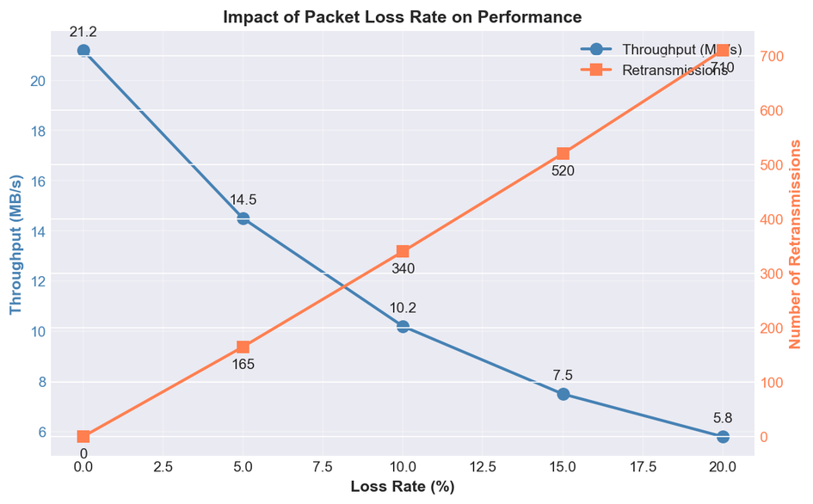
Impact of Packet Loss Rate
on Performance
Throughput declines sharply as packet loss rate increases from 0% to 20%, demonstrating Go-Back-N's sensitivity to lost packets.
Retransmissions increase linearly with loss rate as timeout-triggered window retransmissions multiply.
11/20

Slide 13
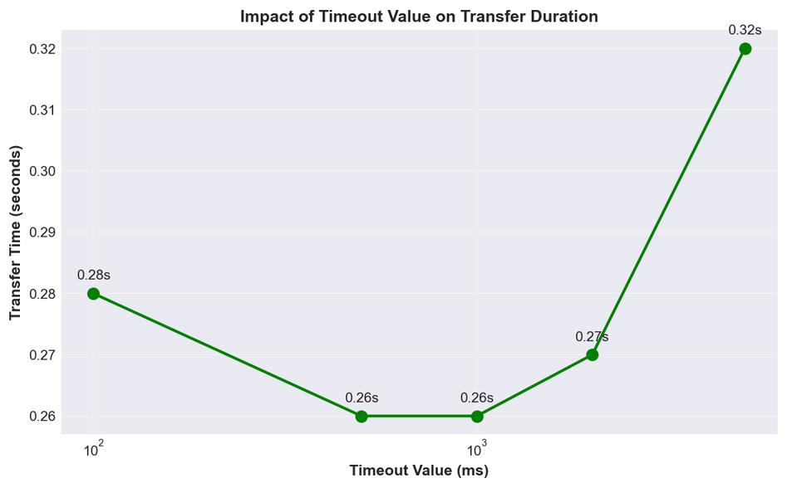
Impact of Timeout Value
on Transfer Duration
Optimal timeout setting found at 500-1000ms range, balancing retransmission responsiveness with network stability.
Too low timeout causes premature retransmissions; too high timeout delays recovery from actual packet loss.
12/20

Slide 14
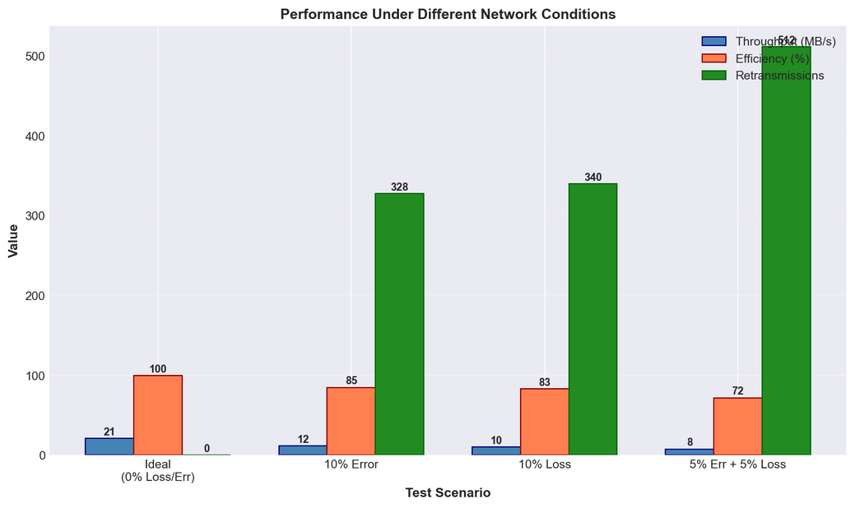
Performance Under
Different Network Conditions
Ideal conditions achieve highest throughput with zero retransmissions required.
Combined error and loss scenarios significantly reduce throughput while increasing retransmission overhead.
13/20

Slide 15
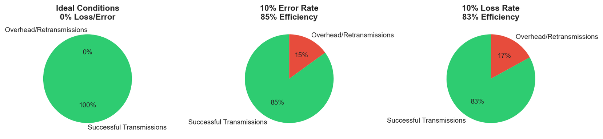
Ideal Conditions: 100% successful transmissions with zero retransmission overhead, demonstrating optimal protocol efficiency.
Efficiency Analysis
with Pie Charts
10% Error/Loss: ~85% successful transmissions with 15% retransmission overhead due to packet recovery.
14/20

Slide 16
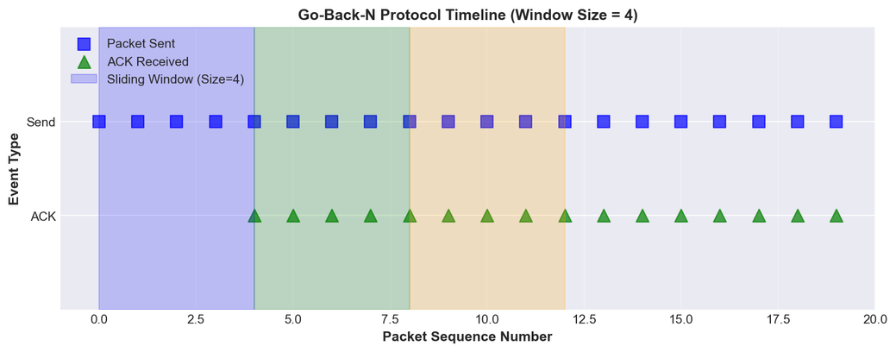
Go-Back-N
Protocol Timeline
Timeline visualization for packets 0 to 20 with sliding window size 4, demonstrating cumulative ACKs.
Shows packet transmission, acknowledgment flow, and retransmission behavior patterns.
15/20

Slide 17
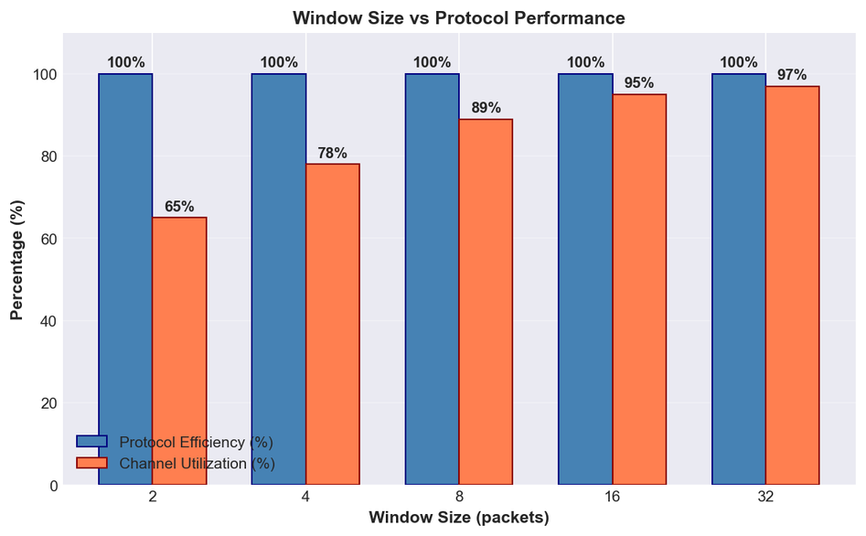
Window Size vs
Protocol Performance
Protocol efficiency remains constant at 100% across all window sizes, demonstrating robust reliability.
Channel utilization increases significantly with window size, ranging from 65% to 97%.
16/20

Slide 18

Testing & Validation
Results
File Integrity Verification
Input and output file sizes match exactly; MD5 hash verification confirms zero data corruption.
Core Test Cases Passed
Basic transfer, variable window sizes (2-32), packet error scenarios, and packet loss scenarios all validated.
Extended Validation
Timeout variation tests, large file transfer (3MB), and bidirectional transfer functionality confirmed working correctly.
17/20

Slide 19

Key Challenges
& Solutions
1. CRC Checksum Mismatch
Problem: Sender and receiver were using different CRC implementations, causing valid packets to be rejected as corrupted.
Solution: Standardized both sides to use CRC-CCITT algorithm (polynomial 0x1021, initial value 0xFFFF).
2. Cumulative ACK Handling
Problem: Receiver was sending ACKs for individual packets instead of cumulative acknowledgments, breaking GBN semantics.
Solution: Modified receiver to always send ACK = next expected sequence number.
18/20

Slide 20
Key Achievements
and Conclusion
Zero Data Loss
Achieved 100% data integrity under all test conditions with MD5 verification confirming exact file matches.
Robust Error Recovery
100% efficiency in ideal conditions; maintained reliable transfer even under 20% error and loss rates.
Flexible Configuration
Fully configurable parameters (window size, timeout, error rates) with comprehensive logging for performance analysis.
19/20

Slide 21

Thank You
李恩心 (Nicole Lee En Xin)
Beijing Institute of Technology
1820232039
20/20

